Slide 1

SDET Course
Design Patterns - Builder

Slide 2
3 Types of Design Patterns
Creational
  Singleton
  Builder
  Prototype
  Factory Method
  Abstract Factory
Structural
  Adapter
  Composite
  Proxy
  Flyweight
  Bridge
  Facade
  Decorator
Behavioral
  Strategy
  Observer
  Command
  Memento
  State
  Template Method
  Mediator
  Chain of Responsibility
  Interpreter
  Visitor
  Iterator

Slide 3
Agenda
Description
Diagram
Code sample (Java)
Use cases

Slide 4

Description
Introduction - Order a Custom Sandwich

Slide 5
Description
The Builder pattern is a creational design pattern that allows for the construction of complex objects step by step. It's especially useful when an object needs to be created with many possible configurations and parameters, some of which may be optional. The Builder pattern helps to maintain clean code with clear separation of concerns and makes the object construction process more controlled and flexible.

Slide 6
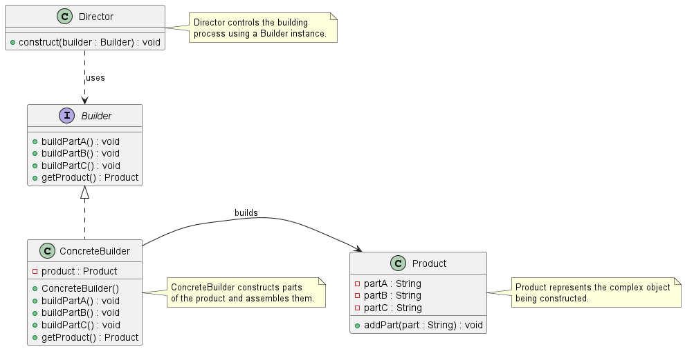
Class Diagram

Slide 7
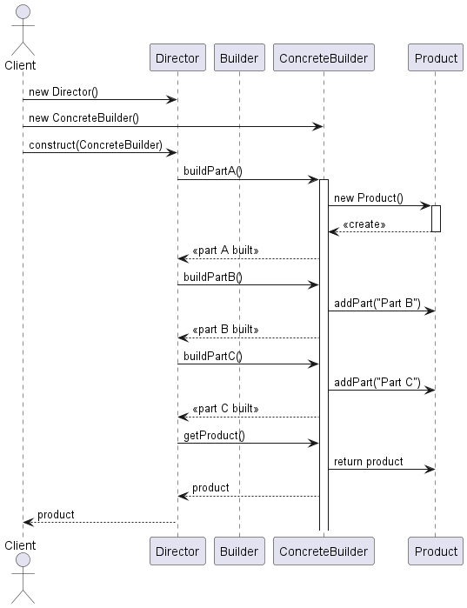
Sequence Diagram

Slide 8
Code Sample

Slide 9
Use cases
General
  Configuration file
  SQL Query builder
  Serialization object
In Test Automation
  Test data object
  Serialization of Json / XML

Slide 10
Happy Coding

